Slide 1
Memicals Tutorial
Eric Fagerburg
(with a big tip of the hat to Roy Stevens)
Updated 08/21/2019

Slide 2
What is memicals?
A collection of memory stress algorithms and debug assist functions including learning algorithms
  Stress typically used in SV to find functional bugs
  Worst case pattern learning typically used in EV to find electrical/margin issues
Stress is optimized by using assembly language in the critical time loops
  Uses SSE2 extensions – simd
  Using 128 bit XMM registers
  Some algorithms use AVX extensions, 256 bit YMM registers, 512 bit ZMM registers
    See Algorithms that use YMM or ZMM registers
Multiple instances may be run as separate processes
Currently supported in SVOS and Maestro
  Used to be supported for Linux, Windows (with cygwin), Mac, and Metro
  See Functionality exception list

Slide 3
How does memicals work?
Memicals algorithms supply the data and addresses for transactions on-the-fly.
  No extraneous reads or writes
There are two types of stress, data and address
  For data stress, an algorithm generates the data for memory WRITES and the expected data for comparison to memory READS.
  For address stress, an algorithm generates the address for memory WRITES and the address for read comparison. The data is typically the physical address.
The algorithms need to be fast so that the memory accesses provide the most stress.
How do we avoid just testing the cache?
  Caching is controlled in x86 by using movntdq instruction for writes
    Writes do not allocate in the cache
    If it’s already there, it will be evicted
ECC and scrambling should be turned off

Slide 4
Memicals memory operation
Memicals targets can be:
  write-back, write-through, write-combining, or uncachable.
  Avoid write-combining unless you are sure. Memicals can see miscompares because write-combining is not coherent.
Memicals algorithms have been optimized to be most efficient testing in write-back mode. Others can run painfully slow. Uncachable will run about 16x slower.
Cacheline writes: Memicals generally tries to avoid partial writes by writing four 128 bit writes in quick succession which will coalesce in a coherent push buffer. The write will then be sent to the memory as a full cacheline write. Warning, memicals cannot guarantee 100% cacheline writes.
Partial writes: Memicals has special algorithms to force partial writes. These will run very slowly due to sfence to force partials.
Memory reads: for write-back and write-through type memory cacheline reads are allowed to be cached and data is examined from there. Subsequent movntdq writes will invalidate entries.

Slide 5

How is memicals controlled
Memicals control varies depending on whether it is running on SVOS, Linux, Windows, Mac, Metro or Maestro.
SVOS/Linux/Windows/Mac
  Memicals instance is controlled by command line options or arguments file or both.
  Example command line: “memicals -algorithm=lfsr -verbose=9 -writeOnce”
  Memicals checks for the existence of a file called memicalsArgs. Options found there are added. This is an example of the format:
Metro
    Memicals checks for the existence of a file called memicalsArgs. Example show above.
Maestro
    Memicals uses a bling file

Slide 6
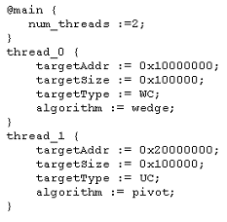
How is memicals controlled
Maestro
    Memicals uses a bling file where each thread running in parallel is specified.

Slide 7
Additional OS based memicals control
Operations may be altered or inspected by sending a command to a running instance
  Example “memicals -command=changeOption:m1 –delay=2”
Status may be acquired by sending a command to a running instance
  Example “memicals -command=showMailbox”
  Example “memicals -command=showStatus”

Slide 8
Options for termination
-iterations: (inner loop) memicals uses this as the number of loops of a an algorithm to do before changing parameters or changing targets. It determines “test” size. Default is 100.
-count=: (outer loop) the number of times the test will run. Default is zero which means run forever. On Maestro, the default is 1.
-time: number of minutes to run. For example: memicals -time=3 will terminate after three minutes. OS only.
-rolloverCount: Specifies how many times the test should progress entirely through memory using changeTargets. For example:
  memicals –changeTargets –rolloverCount=2
  Go though memory twice and terminate.
-continueOnError: Normally memicals will terminate on finding an error. This option allows memicals to keep running looking for more errors.
-holdTarget: Normal operation for memicals is to release the target and terminate. This option causes memicals to hold the target for further inspection via ITP, etc. OS only.

Slide 9
Options, general
-algorithm: selects algorithm for test. Default is fastRandom.
-id: This is to assign a name to a memicals instance so that messages are identified by id instead of process id. Commands can also be sent in to a running memicals by assigned id. OS only.
-verbose: determines the amount of output messages from memicals while running stress. The higher the number the more that is shown. Max is 10. Default is to say nothing while looking for errors.
-bind: binds the memicals process to a specific processor, i.e. –bind=/sv/cpu-02. default is no binding. OS only.
-initialSeed: some algorithms use the random number generator. This can be forced to a different starting value by using this option.
-lax: relax strict type checking of options on command line. Useful for making scripts with options present but disabled by simply removing the dash. OS only.
-noColor: Normal console printing contains color for emphasis. If capturing screen output for a file this option will strip color codes. OS only.

Slide 10
Options for targeting
-target: for selecting the location and properties of the memory block to be tested. Format is ‘path:physicalAddress:size’. For SVOS size limit is 4GB (32 bits). Metro and Maestro limit is 64 bits.
    Example targets:
      –target=/sv/write-back:0x40000000:0x800000 selects 8MB of write-back memory at location 1G.
      –target=/sv/write-through:any:0x800000 selects 8MB of write-through memory at any location SVOS chooses.
    Default is write-back:any:0x1000000.
    For Linux/Windows/Mac/Metro “/sv/” is not required. Only memory type.
  Maestro targeting is a different format. The bling file will specify the targeting information in the following format:
    targetAddr := 0x10000000;
    targetSize := 0x100000;
    targetType := WC;

Slide 11
Options for targeting
  -targetSlice: may be used to specify a slice size to cut a large initial target into a pool of many smaller targets to be used with –changeTargets. This will run faster than normal changeTargets because memicals retains ownership of initial target.
    Example: memicals –changeTargets –targetSlice=0x1000000 -target=/sv/write-back:any:0x10000000
    This will cause memicals to use 16 different targets within the large initial target
    Multiple memicals can use the same pool target
      Instead of “any”, pass the same address in each -target parameter
  -randomSlice: specifies that the slice targets will be acquired in random order instead of sequentially

Slide 12
Options for read write control
-writeOnly: data is only written, no read verification, used to provide write aggravation or determine write bandwidth.
-writeOnce: data is written once, only reads and test after that, used when looking for read errors when you don’t need data to be changing
-lag: for controlling amount of overlap between writes and reads. Default operation is lag=0, no overlap, all write then all reads. Lag can be used to bring reads closer to writes and generate alternating rd/wr traffic.
  No lag: W1, W2, W3, W4, W5, …Wn R1, R2, R3, R4, R5, …Rn
  lag=2: W1, W2, R1, W3, R2, W4, R3, W5, R4, …Wn, Rn-1, Rn
-memoryPreInitialized: special option to indicate that a specific target should already contain the correct pattern and should only be read and confirmed.
-syncPoint: will cause multiple memicals to run synchronously. Can be set to write or read. Example: syncPoint=write will cause all participating memicals to enter a barrier before the write phase.
-noVerify: reads are still done but any mismatch is ignored

Slide 13
Options for sequence and direction
-addrMatchMask, -addrMatchValue: used in combination with to indicate an address template. Mask is bits to control and Value is the value. This can be used with data algorithms to target specific Channel/DIMM/Rank/Bank. Mask indicates which bits to control and Value sets the requirement. Example:
  Address bits 6 and 7 determine channel
  Address bits 12 and 13 determine rank
  Target channel 1, rank 3
  -addrMatchMask=0x30c0, -addrMatchValue=0x3040
-descend: instructs memicals data algorithms to run backwards, doing accesses from higher memory toward lower memory.
-stride, -strideStart: used where memory is interleaved on non-binary basis. Example: 3-way interleaving for 3 memory channels. -stride=3 directs address sequence is advanced 3 cachelines for each transfer. Option –strideStart allows targeting specific channel i.e. for stride=3, strideStart may be 0,1,2. Target addresses are where ((physAddr % stride) == strideStart)

Slide 14
Options parameters
-numCL: specifies the number of cachelines burst by the algorithm. Currently used only by cacheline, constant, multiWriteCacheline algorithms. Default is one.
-constant: specifies constant dword data for testing, used to set a whole cacheline to a specific dword i.e. -constant=0xa5a5a5a5
-cacheline: specifies an entire cacheline as a constant, enter as string, i.e. –cacheline=00000000_111111112222222233333333444444445555555566666666777777778888888899999999aaaaaaaabbbbbbbbccccccccddddddddeeeeeeeeffffffff
-criticalChunk: specifies which 16 byte chunk of the 64 byte cacheline is requested first on reads. Choices are 0,1,2,3. Default is 0. Example –criticalChunk=1 will cause access offset 0x10 in cacheline first.
-pivotAddr: used to specify an address to be used in a special way by some algorithms.
-cachelineOriented: specifies that an algorithm should apply to the whole cacheline. Currently applies to walkingBits and dancingBits. Default is to apply algorithm to dword or qword.

Slide 15
Options parameters (continued)
-suppressInvert: prevent inversion of data. Some algorithms (like cacheline) will invert the data each pass though memory because it is a more rigorous test.
-wedgeSize: sets the wedge size for the wedge algorithm.
-pcommit: causes memicals to execute a pcommit instruction after the write phase. This is for persistent memory. Warning, The memicals lag option cannot be used with this type of memory because reads and writes are mixed.
-stallCount: specifies the number of TSC ticks memicals wil stall after write phase and read phase. Default is zero.
-delay: specifies a micro delay. Value is loaded into rcx and then the loop instruction is used to jump back to itself that many times.
-doNotCorrectErrors: memicals normally corrects an error in memory when it is detected and processed. This option prevents this so that the error is left in memory and can be inspected by other means such as ITP.

Slide 16
Options for changes between tests
-changePivot: After a set of iterations has run of a test that used the pivot address, the pivot address will move to the next legal value. This can be used to automatically cycle through all legal values.
-changeWedge: After a set of iterations of the wedge algorithm has run, the wedge size will automatically cycle through all legal values.
-changeTargets: After a set of iterations has run, the current target is released and a new target of the same type and size is acquired before continuing. Useful for walking a test through all existing memory.
-changeCritical: After a set of iterations has run, the critical chunk indicator will automatically advance. Useful for testing all variations of critical chunk automatically. Warning, this is just an attempt to make the processor access a different first critical chunk and it may be ignored.

Slide 17
Options for changes between tests cont.
-bandwidthTarget: causes memicals to self adjust to a specific bandwidth target, i.e. –bandwidthTarget=1000 will cause memicals to adjust over several runs to a 1GByte/sec rate. Useful for creating set bandwidth for power testing or for controlled background activity. OS only.
-changeStallCount: causes memicals change stallCount to random percentage of the original stallCount value
-changeDelay: causes memicals loop through all delay values up to original delay
-changeBind: causes memicals to bind to a random cpu, but different from the current cpu.

Slide 18
Options for error printing
Default is to show only dword in error:
  ID 1234 ERR A: 0x000280000000 R:0x00000000 E:0x00000001 XOR:0x00000001 2nd:E
-showCachelineError: causes memicals to display the entire cacheline when an error is detected instead of just the dword. OS only.
  30132 Err #1 A:0x81021000 Cacheline, , sec/err=0.0000 xfer/err=1.00
  Read: 246F987d 84E011B5 6C58F30F 48357579 64CE1049 BA20D985 57C9A757 60E03A1A
  71728B74 7865CC0C 3E28D60C BAB46AC6 601C1285 79DF3E51 B8ADBCD0 DEADBEEF
  Exp: 246F987C 84E011B5 6C58F30F 48357579 64CE1049 BA20D985 57C9A757 60E03A1A
  71728B74 7865CC0C 3E28D60C BAB46AC6 601C1285 79DF3E51 B8ADBCD0 FD86B047
  XOR: 00000001 00000000 00000000 00000000 00000000 00000000 00000000 00000000
  00000000 00000000 00000000 00000000 00000000 00000000 00000000 00000000
  2nd: Same as Read
-showWaveformError: causes memicals to display the cacheline waveform with the error indicated. OS only.
  30133 | 1| 2| 3| 4| 5| 6| 7| 8|
  30133 DQ00: _X_____________________ 1
  30133 DQ01: ^^\__/^^^^^\__/^^\__/^^
  30133 DQ02: __/^^\__/^^^^^\__/^^\__
  30133 DQ03: _____/^^^^^^^^^^^\__/^^
  30133 DQ04: ^^^^^\________/^^^^^^^^
  30133 DQ05: ^^\___________/^^^^^\__
-doNotShowErrors: no errors are shown or logged. Useful when errors are numerous and statistics are being gathered. OS only.

Slide 19
Options for triggering
-laTriggerLocation=: physical address to write to in the event of an error to trigger a logic analyzer. A whole cacheline of 0xdeadbeef will be written immediately after a miscompare. Not available in Metro.
-triggerPort=: specifies a trigger port. Zeroes are written at the entry of the test and all ones are written if an error is encountered, providing a rising edge for scope triggers. Default is port 0x80.
-testError: causes memicals to test the trigger by poisoning the buffer with “deadbeef” and “baadf00d” after the write so it will be found as an error and issue all triggers. Useful for testing LA and scope triggers settings. When used memicals will also print the virtual address of the trigger code for that algorithm that can be used for CPU breaks:
  miscompare code virtual address=0000000000418718
-breakpointMarkers: causes bp0 to be issued just before and just after read or write activity and bp1 to be issued on read miscompare.

Slide 20
Options for logging
-nolog: suppresses log generation, useful for interactive debug where you don’t need a log
-logPath: The default log path is /var/log. This option allows the user to specify a different path. OS only.
-comment: allows user to add a comment that will be printed on the screen and placed in the log. OS only.

Slide 21
Options for commands, OS only
-command: issues commands to running instances of the program or gathers information about hung memicals. Does not run an algorithm.
addressAnalysis - shows error analysis of address bits seen high or low on errors
backtrace - show backtrace of memicals pseudo stack in mailbox
clearMailbox - clears memicals shared memory mailbox
fixMailbox - removes dead memicals shared memory mailbox
initMemoryMap - init SVOS/Linux/Win/Mac target memory free list
kill - usage kill:memicalsId, send control-c to named process
logComment - used with -comment, causes comment to be added to log
series – gather statistical info of a series of tests and display as a distribution and time series. -number option used to specify size up to 1024

Slide 22
Options for commands cont.
showMailbox - show memicals mailbox, common info and system info and details of each running memicals
showStatus - shows details of individual memicals instance
showWaveform - shows graphical representation of current memicals waveform
showActivity - shows LA type trace of running memicals used with -zoom = number to zoom
monteCarloScoreMaster - shows combined Monte Carlo score for all failing bits
monteCarloScore - show Monte Carlo score for failing bits
showMemoryMap – show the available memory target areas

Slide 23
Algorithms
Data Stress Algorithms
  touch, writeCount, writePartial, writePartial2, writePartialCacheline, randomData, fastRandom, lfsr, byteAdd, constant, cacheline, multi-writeCacheline, wedge, walkingBits, dancingBits, slam, phyAddr, xTalk, single, refresh
  Can be sequential addresses or use addrMatch to target memory
  Writes are usually 4 128 bits writes which are generally coalesced into a single cacheline write
Address Stress Algorithms
  randomAddr, greyaddr, pivot, pager, switchAddr, addrBitCompare
  Data is generally the physical address of the cacheline

Slide 24
touch
Simplest of algorithms
No data checking, rely on ecc for checking
Sequential or addrMatch addressing
Writes “cacheline” option data
Reads only a dword to cause cacheline to be accessed
Fastest access possible
Useful for bandwidth measurement, aggravator, or testing using ecc

Slide 25
constant
For testing data patterns
Sequential or addrMatch addressing
Same pattern in each dword
Dword pattern set by “constant” option
Can be same data pattern repeated or inverted on each pass, controlled by “suppressInvert” option
Default to aaaaaaaa
Example, -constant=0x12345678
  12345678 12345678 12345678 12345678
  12345678 12345678 12345678 12345678
  12345678 12345678 12345678 12345678
  12345678 12345678 12345678 12345678

Slide 26
cacheline
For testing data bit dependencies or pattern sensitivity
Sequential or addrMatch cacheline addressing
Entire cacheline may be specified by “cacheline” option
Can be same data pattern repeated or inverted on each pass, controlled by “suppressInvert” option
Example: -cacheline=00000000111111112222222233333333444444445555555566666666777777778888888899999999aaaaaaaabbbbbbbbccccccccddddddddeeeeeeeeffffffff
  00000000 11111111 22222222 33333333
  44444444 55555555 66666666 77777777
  88888888 99999999 aaaaaaaa bbbbbbbb
  cccccccc dddddddd eeeeeeee ffffffff

Slide 27
writePartialCacheline
Same as cacheline but all writes are forced out as partials writes
  Sfence is issued after each quarter cacheline (xmm) write
  This causes each write to consist of four partial write transfers that must be merged by memory controller
  The extra transfers and serializing cause this algorithm to run slowly. Smaller buffers should be used to avoid appearing hung.

Slide 28
count
Simply writes a count to dwords
Sequential or addrMatch addressing
Useful for diagnosing simple memory problems
Fast easy generation
  00000000 00000001 00000002 00000003
  00000004 00000005 00000006 00000007
  00000008 00000009 0000000a 0000000b
  0000000c 0000000d 0000000e 0000000f

Slide 29
writePartial
Same as count but all writes are forced out as partials writes
  Sfence is issued after each quarter cacheline (xmm) write
  This causes each write to consist of four partial write transfers that must be merged by memory controller
  The extra transfers and serializing cause this algorithm to run slowly. Smaller buffers should be used to avoid appearing hung.

Slide 30
writePartial2
Same as count but all writes are forced out as partials writes
  Sfence is issued at various places in cacheline write, subsequent cacheline writes loop using the following sequence
    One quarter, sfence, three quarters, sfence
    Two quarters, sfence, two quarters, sfence
    Three quarters, sfence, one quarter, sfence
  This causes each write to consist of two partial write transfers that must be merged by memory controller
  This algorithm runs twice as fast as plain writePartial

Slide 31
randomData
Pseudo random data patterns
Sequential or addrMatch addressing
Virtual address is used as seed
  XOR with random value
  rotate random amount
Every cacheline has a different value
Data can be anything but pattern is obvious
Good for general data stress testing

Slide 32
fastRandom
Pseudo random data patterns
Sequential or addrMatch cacheline addressing
Starts with 256 bit random seed
Uses fast XMM (or YMM or ZMM) multiply to generate next pattern
This is the truly random data test
Good for initial stress testing and BER testing

Slide 33
maskRandom
Same as fast random but a mask can be applied to control specified bits
Option -cachelineMask indicates which bits to control
Option –cacheline indicates the value to impose

Slide 34
lfsr
Standard Linear Feedback Shift Register
64 bit lfsr for random data patterns
Bits 63, 62, 60, 59 xor to next lsb
Sequential and addrMatch addressing
Eight per cacheline
Doesn’t repeat in thousands of years
New bit shifted into lsb
  1001000110101101110110100011101010101011110101011010010101010101
  0010001101011011101101000111010101010111101010110100101010101010
  0100011010110111011010001110101010101111010101101001010101010100
  1000110101101110110100011101010101011110101011010010101010101001
  0001101011011101101000111010101010111101010110100101010101010010
  0011010110111011010001110101010101111010101101001010101010100100
  0110101101110110100011101010101011110101011010010101010101001001
  1101011011101101000111010101010111101010110100101010101010010010
  1010110111011010001110101010101111010101101001010101010100100101

Slide 35
byteAdd
Data pattern generation
Sequential or addrMatch addressing
Very fast algorithm for interesting patterns
Some bits change every time, some every 2nd time, etc
All bytes in quadword (128 bit) set to a random byte
Next pattern generated by adding pattern again
Example
  13131313 13131313 13131313 13131313
  26262626 26262626 26262626 26262626
  39393939 39393939 39393939 39393939
  4c4c4c4c 4c4c4c4c 4c4c4c4c 4c4c4c4c
  5f5f5f5f 5f5f5f5f 5f5f5f5f 5f5f5f5f
  72727272 72727272 72727272 72727272
Etc

Slide 36
multiWriteCacheline
For testing coherent push buffers and write queue operation
Similar to cacheline except there are multiple writes to an address
Sequential or addrMatch cacheline addressing
Entire cacheline may be specified by “cacheline” option
Operation:
  Write phase consists of writing (bad) inverted data n times immediately followed by correct data
  Read phase is normal cacheline data comparison, only last write should be seen.
Memicals option –numExtraWrites specifies how many extra writes will be performed. Default is one.

Slide 37
wedge
For testing data bit dependencies or pattern sensitivity
Sequential or addrMatch cacheline addressing
Useful for exposing memory cell weakness
Wedge “size” is controllable
Ones or zeros are marched in from lsb
Wedgesize up to 63
Example wedgeSize= 31
  00000000000000000000000000000001
  00000000000000000000000000000011
  00000000000000000000000000000111
  00000000000000000000000000001111
  …
  00111111111111111111111111111111
  01111111111111111111111111111111
  11111111111111111111111111111110
  11111111111111111111111111111100
  ...
  11100000000000000000000000000000
  11000000000000000000000000000000
  10000000000000000000000000000000
  00000000000000000000000000000001

Slide 38
walkingBits
For testing data bit dependencies or pattern sensitivity
Sequential or addrMatch cacheline addressing
All single bits are set to one and alternately set to zero in dword
Can be forced to walk whole cacheline by option -cachelineOriented
All cachelines written with same pattern before going to next pattern
  00000000000000000000000000000001
  11111111111111111111111111111110
  00000000000000000000000000000010
  11111111111111111111111111111101
  00000000000000000000000000000100
  11111111111111111111111111111011
  ...
  00100000000000000000000000000000
  11011111111111111111111111111111
  01000000000000000000000000000000
  10111111111111111111111111111111
  10000000000000000000000000000000
  01111111111111111111111111111111

Slide 39
dancingBits
For testing data bit dependencies or pattern sensitivity
Sequential or addrMatch cacheline addressing
Like walkingBits but all combinations of two bits are set to one and alternately set to zero in dword
  00000000000000000000000000000011
  11111111111111111111111111111100
  00000000000000000000000000000101
  11111111111111111111111111111010
  00000000000000000000000000001001
  11111111111111111111111111110110
  ...
  01100000000000000000000000000000
  10011111111111111111111111111111
  10100000000000000000000000000000
  01011111111111111111111111111111
  11000000000000000000000000000000
  00111111111111111111111111111111

Slide 40
slam
Writes all ones when the “pivotAddr” is one
Writes all zeros when the “pivotAddr” is zero
Operation inverts on next pass
Sequential or addrMatch cacheline addressing
Used to create resonances coincident to address line by driving all zeros and then all ones for a period

Slide 41
phyAddr
Simply writes the physical address to the memory location of that address
Sequential or addrMatch addressing
Useful for using LA with simple memory errors: the data is the address, no decoding, no swizzles
Data is always the same, no inversions

Slide 42
writePartialPhyAddr
Same as phyAddr but all writes are forced out as partials writes
  Sfence is issued after each quarter cacheline (xmm) write
  This causes each write to consist of four partial write transfers that must be merged by memory controller
  The extra transfers and serializing cause this algorithm to run slowly. Smaller buffers should be used to avoid appearing hung.

Slide 43
xTalk
Writes a rotating victim/aggressor pattern into memory to provoke a crosstalk/resonance/power delivery issue.
Victim and aggressor patterns go though all interesting combinations
Sequential or addrMatch addressing
Example for 2 sequential cachelines
  Ch1 DQ00: _____/^^\__/^^^^^\___________/^^\__/^^^^^\_____
  Ch1 DQ01: _____/^^\__/^^^^^\___________/^^\__/^^^^^\_____
  Ch1 DQ02: _____/^^\__/^^^^^\___________/^^\__/^^^^^\_____
  Ch1 DQ03: _____/^^\__/^^^^^\___________/^^\__/^^^^^\_____
  Ch1 DQ04: _____/^^\__/^^^^^\___________/^^\__/^^^^^\_____
  Ch1 DQ05: _____/^^\__/^^^^^\___________/^^\__/^^^^^\_____
  Ch1 DQ06: __/^^^^^^^^\_____/^^^^^\__/^^^^^^^^\_____/^^^^^
  Ch1 DQ07: _____/^^\__/^^^^^\___________/^^\__/^^^^^\_____
  Ch1 DQ08: _____/^^\__/^^^^^\___________/^^\__/^^^^^\_____
  Ch1 DQ09: _____/^^\__/^^^^^\___________/^^\__/^^^^^\_____
  Ch1 DQ10: _____/^^\__/^^^^^\___________/^^\__/^^^^^\_____
  Ch1 DQ11: _____/^^\__/^^^^^\___________/^^\__/^^^^^\_____
  Ch1 DQ12: _____/^^\__/^^^^^\___________/^^\__/^^^^^\_____
  Ch1 DQ13: _____/^^\__/^^^^^\___________/^^\__/^^^^^\_____
  Ch1 DQ14: __/^^^^^^^^\_____/^^^^^\__/^^^^^^^^\_____/^^^^^
  Ch1 DQ15: _____/^^\__/^^^^^\___________/^^\__/^^^^^\_____
  Ch1 DQ16: _____/^^\__/^^^^^\___________/^^\__/^^^^^\_____
  Ch1 DQ17: _____/^^\__/^^^^^\___________/^^\__/^^^^^\_____
  Ch1 DQ18: _____/^^\__/^^^^^\___________/^^\__/^^^^^\_____
  Ch1 DQ19: _____/^^\__/^^^^^\___________/^^\__/^^^^^\_____
  Ch1 DQ20: _____/^^\__/^^^^^\___________/^^\__/^^^^^\_____
  Ch1 DQ21: _____/^^\__/^^^^^\___________/^^\__/^^^^^\_____
  Ch1 DQ22: __/^^^^^^^^\_____/^^^^^\__/^^^^^^^^\_____/^^^^^
  Ch1 DQ23: _____/^^\__/^^^^^\___________/^^\__/^^^^^\_____
  Ch1 DQ24: _____/^^\__/^^^^^\___________/^^\__/^^^^^\_____
  …..

Slide 44
single
Writes a cacheline of data to a single address
Can write many times and read many times determined by buffer actual size
Data is always the same, no inversions

Slide 45
refresh2
For exposing the “row hammer” issue in drams
Initializes huge buffer
Possible victim rows are initialized to “1”
Many threads bash dual random cachelines straddling a victim row by writing “0”s,
Excessive bash of rows accentuates leakage in adjacent rows
Read of buffer looks for leakage errors in dram
Expected data is always “1”s, no inversions
OS memicals versions only

Slide 46
randomAddr
Generates pseudo-random cacheline address sequences
Stresses address sensitivity and paging logic
Index based on addition of prime numbers
Index goes thru series of shift/xor and mask to create psuedo random offset
Data is physical address for easy analysis
When option numCL=4 is used it will access 4 consecutive cachelines pseudo-randomly in the target

Slide 47
greyAddr
Algorithm generates greycode addresses for address sequence for cachelines
Address bit that changes the most often may be specified by “pivotAddr” option
Good for stressing single address line for page comparison logic, bank switching, rank switching, etc
Best if used with large targets

Slide 48
switchAddr
Algorithm generates optimal switching addresses for address sequence for cachelines
Change “all” or “all but one” legitimate cacheline addresses sequentially
Example: target at 0x100000000 and size of 0x1000000
  100000000
  100ffffc0
  100000040
  100ffff80
  100000080
  100ffff40 . . .
Good for stressing cmd bus (address) timing/margin, stresses bank, rank, dimm, channel switching, etc.
Data is physical address

Slide 49
pivot
Tests address sensitivity, focus on a single address bit
Special “pivot” address bit set by options
Memory block is tested with an addressing technique that changes pivot bit every access
Good for stressing single address line for page comparison logic, bank switching, rank switching, etc
Data is physical address

Slide 50
pager
Designed to open as many pages as possible
pagerMask specifies address bits that change the fastest
Example:
  Address bits 12, 13, and 14 control bank
  Address bits 20 and 21 control rank
  pagerMask=0x00307000
  Data is physical address

Slide 51
addrBitCompare
Designed to test the various address comparators a single bit at a time.
  There is a primary address and a secondary address which is different by one bit.
  During write phase primary and secondary address are written to initialize
  During read phase primary and secondary address are written followed by small random delay and then primary address is read and data verified.
  The test is to see if secondary address write interferes with primary address write or read.
Target is not required. Memicals will scan entire memory area for possible targets and perform test wherever applicable.

Slide 52
readForever
Designed to flood memory controller with reads. A pathological case.
Writes phase occurs and read phase is entered. It never comes back.
Control-C will terminate.
Data is not tested.

Slide 53
writeForever
Designed to flood memory controller with writes. A pathological case.
Writes phase is entered. It never comes back.
Control-C will terminate.
Data is not tested.

Slide 54
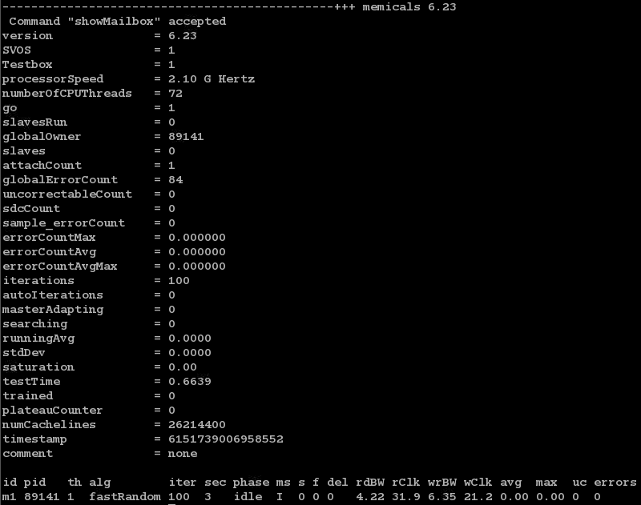
Interactive Command example: showMailbox

Slide 55
Interactive Command example: showMailbox
ShowMailbox shows some interesting system information
  Memicals version, SVOS and testbox status, Processor speed, Number of threads, Global error count, Learning algorithm information, Processor timestamp value
ShowMailbox shows data for each instance of memicals running
  Memicals instance id, process id, thread id, algorithm name, number of iterations, time run in seconds, learning phase, master/slave status, score in progress, freeze status, delay value, read bandwidth, processor clks per read, write bandwidth, processor clks per write, avg errors per run, max errors per million reads, number of uncorrectable errors, total number of errors

Slide 56
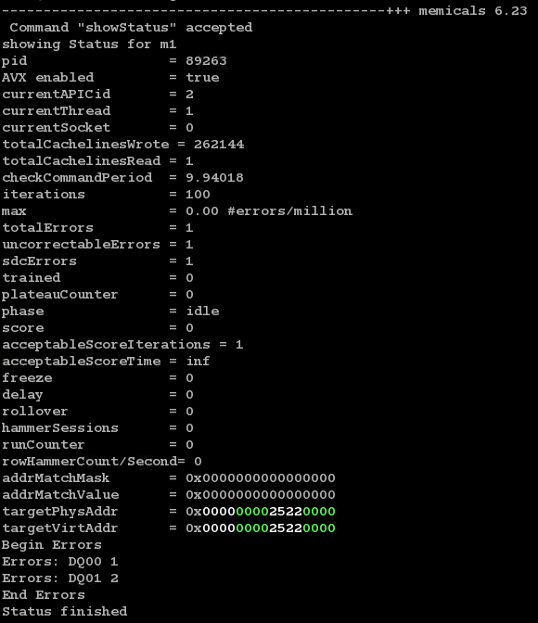
Interactive Command example: showStatus

Slide 57
Interactive Command example: showStatus
ShowStatus gives additional information for each memicals running
  AVX staus, apic id, thread id, socket, total cachelines written and read, basic error information, number of times we have rolled over memory, hammer sessions for refresh hammer algorithms, current addrMatchMask and addrMatchValue, current target virtual and physical address, a list of DQs that have been in error with a count of errors

Slide 58
Interactive Command example: showActivity
ShowActivity gives a Logic Analyzer type display of recent memicals activity of memicals running
  Output includes memicals id, thread id, time basis of activity
  Activity is displayed by using 100 characters and colors for graphic display: “R” for read activity and “W” for write activity.
  If more than one activity code is in the interval “?” is shown
  In this example three memicals are running with alternating read and write activity for the last 0.018 seconds
  Example of read error “E” at beginning of each read phase

Slide 59
Interactive Command example: showActivity
ShowActivity shows special activity
  example change targets with iterations is set to 2 so memicals gets a new target (shown by “T”) every two sets.
  Example of lag=200000. Shows leading writes (W), read/write (B) for both, and trailing reads (R).
  Example of two memicals with syncPoint=write . Shows memicals idle time waiting to synchronize write phase

Slide 60
Interactive Command example: showActivity
ShowActivity can be zoomed in on tail of activity
  Example: memicals –command=showActivity –zoom=2
  Example: memicals –command=showActivity –zoom=5
  Example memicals entering c-state 6 after each read and write phase. Zoom 4.

Slide 61
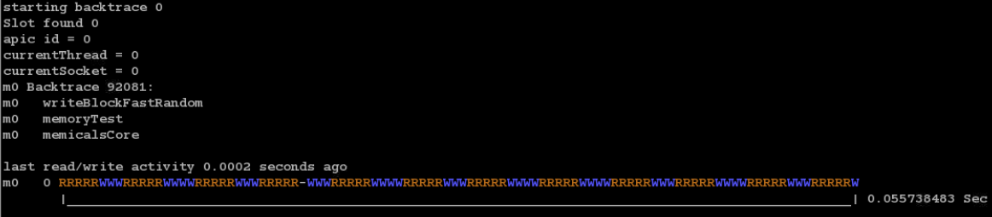
Interactive Command example: backtrace
While running each memicals creates a simple pseudo stack in its mailbox slot. This information can be accessed at any point to create a simple backtrace which displays where memicals instances are in execution. It includes an activity trace.
  Example: memicals –command=backtrace

Slide 62
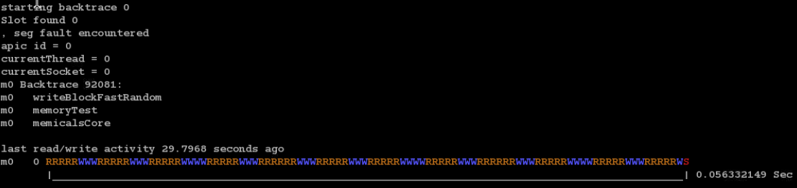
Interactive Command example: backtrace
Backtrace information is available even if the memicals instance is hung or received segmentation fault
  Example: memicals instance that encountered segmentation fault about 30 seconds ago while in writeBlockFastRandom. The “S” in the activity trace indicates a signal.

Slide 63
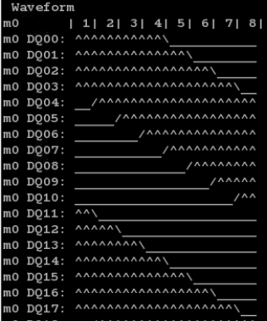
Interactive Command example: showWaveform
While running each memicals saves a sample of the first cacheline of the target on the first iteration. It is read from memory. This cacheline will be displayed as a DDR type waveform showing 8 beats of 64 bits.
Running:
memicals -algorithm=wedge - wedgeSize=7
memicals –command=showWaveform

Slide 64
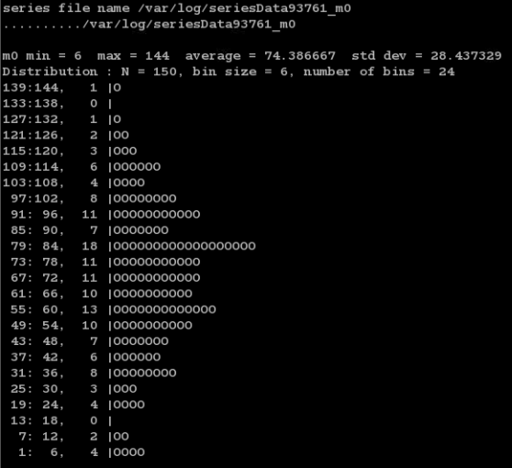
Interactive Command example: series
A memicals instance that is getting errors can be instructed to collect a series of error counts with time and display a distribution of errors. Example: memicals –command=series –number=150
150 error counts are recorded
Distribution is shown vertically
Bell curve observed in this case

Slide 65
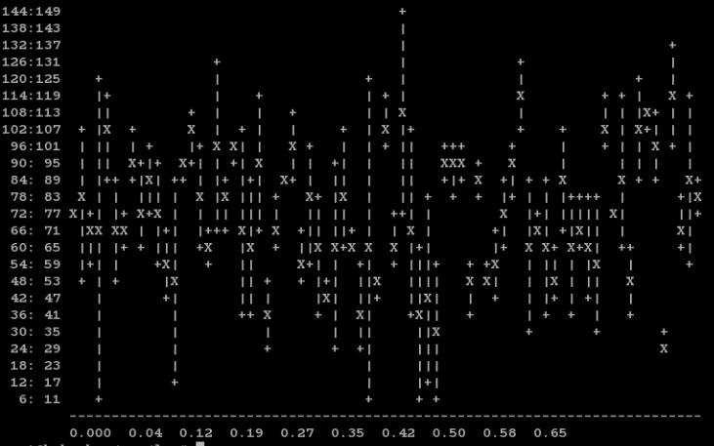
Interactive Command example: series
Error time sequence is also show which matches distribution curve. Error counts vs time.

Slide 66
Backup

Slide 67
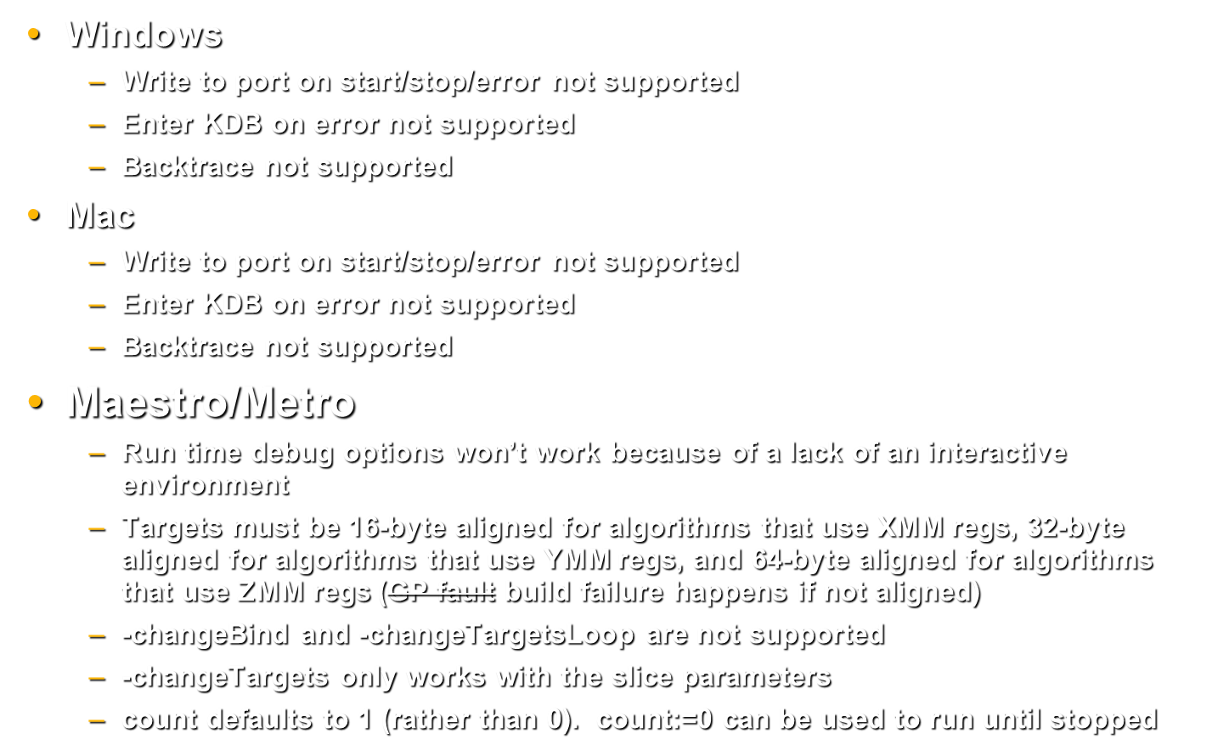
Functionality exception list

Slide 68
Algorithms that use YMM or ZMM registers
Algorithms that use YMM registers
  fastRandom
  constant
  cacheline
  multiWriteCacheline
  walkingBits
  dancingBits
  touch
Algorithms that use ZMM registers
  fastRandom
  constant
  cacheline
  multiWriteCacheline
  walkingBits
  dancingBits

